Slide 1
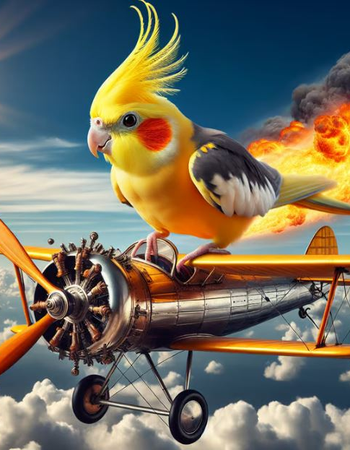
Mitigating Bird Strikes in Aviation
Saravanan S

Slide 2

Introduction
To analyze and mitigate bird strikes using a comprehensive aviation dataset.
To uncover patterns by exploring factors like aircraft type, altitude, species, weather, and impact.
To provide actionable recommendations for safety, cost reduction, operational efficiency, and wildlife conservation.
Leverage Tableau dashboards to communicate insights interactively.

Slide 3

Dataset Overview
Source: Bird Strike Dataset (cleaned in Excel/Python)
Records: ~20,000+
Columns: 26 attributes including:
Aircraft type, altitude bin, wildlife species
Impact on flight, number injured, cost
Sky conditions, pilot warnings, airport info
Visual: Snapshot table of 5–6 fields (e.g., Record ID, Aircraft Type, Wildlife Size, Cost, etc.)

Slide 4
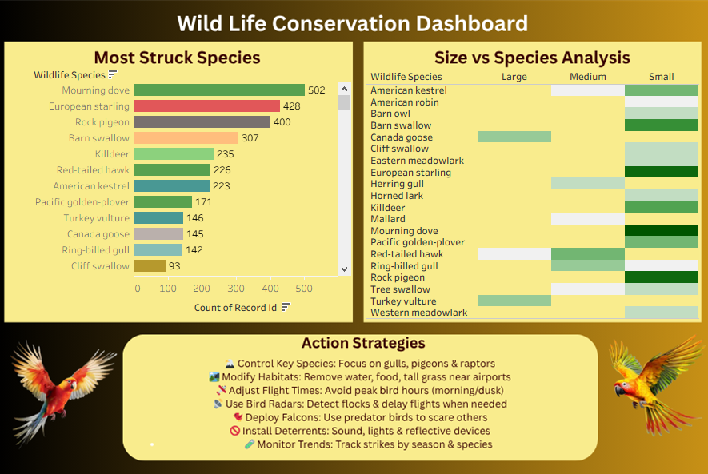
Safety Improvement Dashboard
Dove, pigeons, and Starling are highly involved in strikes. Habitat control, waste management near airports, and falconry could reduce their presence. Small Medium species cause more problematic strikes. Focus should be on deterrence techniques like sound cannons, radar monitoring, and habitat modification

Slide 5
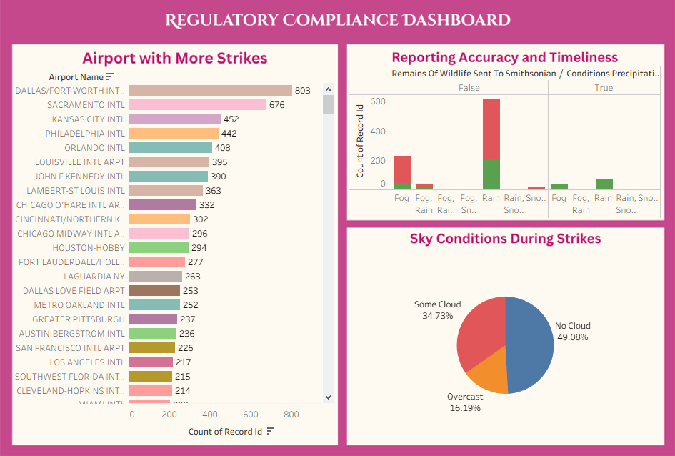
Compliance Dashboard
Reporting appears inconsistent in precipitating conditions; fewer remains are collected or sent to the Smithsonian during rain or snow, raising questions about procedural adherence in adverse weather. Most strikes occurred under clear or partly cloudy skies, possibly due to higher visibility and activity of birds. Severe conditions like storms show fewer strikes, possibly due to reduced flying frequency Dallas, Sacramento are among the top airports reporting bird strikes. These hubs may need enhanced bird control measures and regular audits for compliance with wildlife hazard management plans.

Slide 6

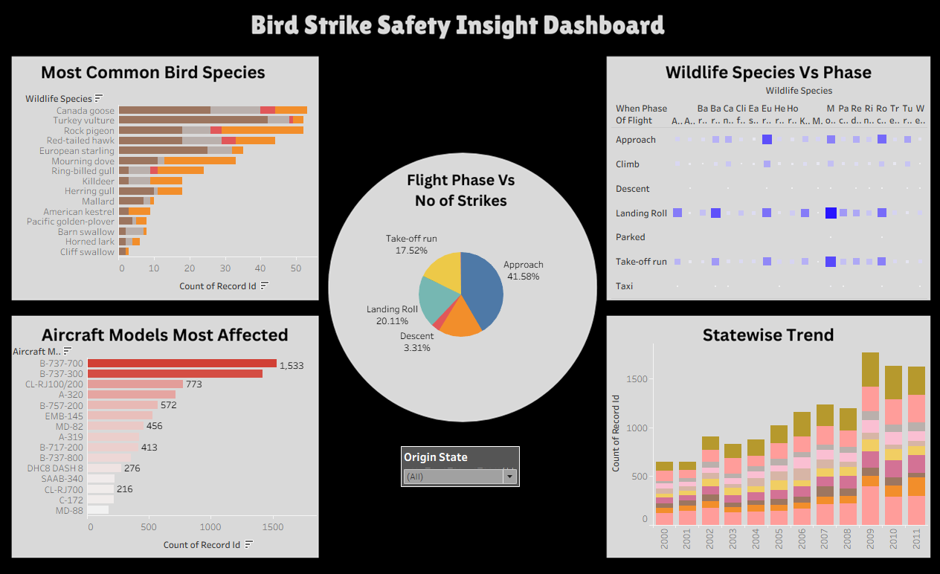
Safety Insight Dashboard
"Most bird strikes occur during approach and landing rolls, suggesting aircraft are most vulnerable at lower altitudes near airports. This insight supports targeted bird control near runways and approach zones.". "Boeing 737, CL RJ100/200 and Airbus A320 are the most commonly struck aircraft models, likely due to their widespread use. However, frequency doesn't necessarily equate to vulnerability—it may correlate with fleet size and routes flown. "Larger species like geese and vultures often strike during climb and cruise, whereas smaller birds tend to strike during approach. This reflects differences in bird flying altitudes and supports targeted control measures based on time and height. "States like Texas , New york, California, Florida show a rising trend in bird strike incidents over the years, possibly due to high airport traffic and wildlife presence. A seasonal or weather-based component may also influence spikes."

Slide 7
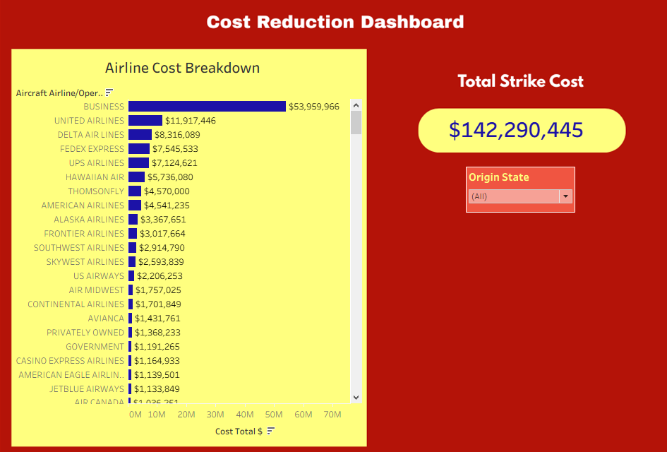
COST REDUCTION & PREVENTION
Programs like radar detection and falconry have low long-term costs but high impact on preventing strikes—ideal for implementation. Airlines with larger fleets (e.g., Delta, United, American) face higher repair costs—strategic investments in prevention can offer significant savings
Cost‑Saving Strategies:
• Avian radar detection
• Falconry programs
• Habitat modification

Slide 8
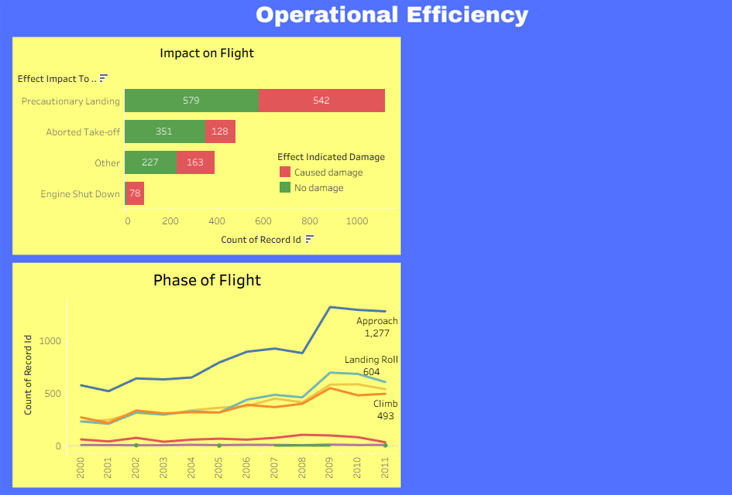
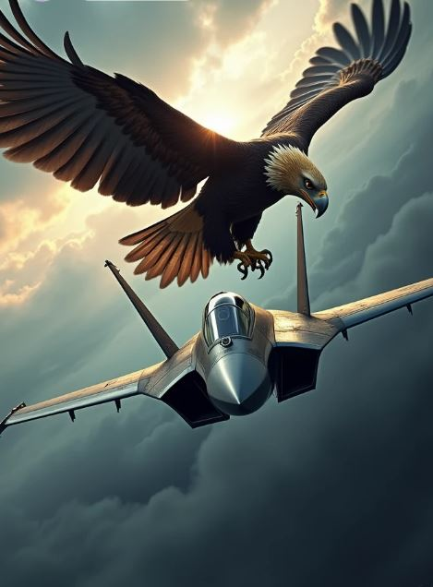
Operational Efficiency
Most bird strikes led to minor operational disruptions, but a noticeable number caused engine shutdowns, emergency landings, and flight delays.
The “Precautionary Landing” and “Aborted Take-off” categories highlight critical safety and efficiency concerns.
These disruptions often lead to flight rescheduling, crew overtime, passenger compensations, and missed connections—affecting airline punctuality KPIs.

Slide 9
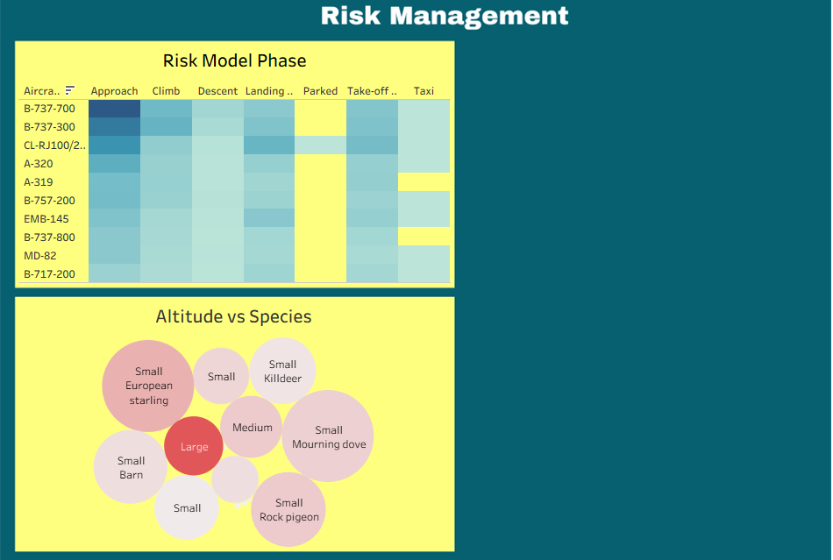

Risk Management
Aircraft models such as the Boeing 737, Airbus A320, and regional jets show higher strike frequency—likely due to their widespread commercial usage.
Most strikes occur at altitudes between 0–3000 feet, especially between 500–1500 feet—this aligns with the bird flying range and airport perimeters.
Overall Risk Factors Identified
Aircraft Characteristics: Larger, dual-engine aircraft more prone to severe outcomes.
Flight Phase: Climb and Approach are most dangerous.
Altitude: 0–1500 ft = highest risk zone.
Location: High-density and coastal airports more exposed.

Slide 10
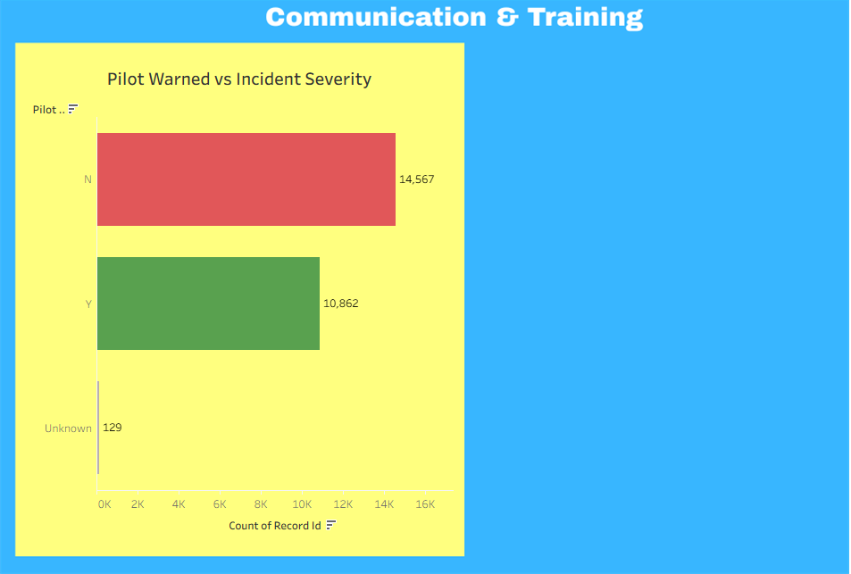
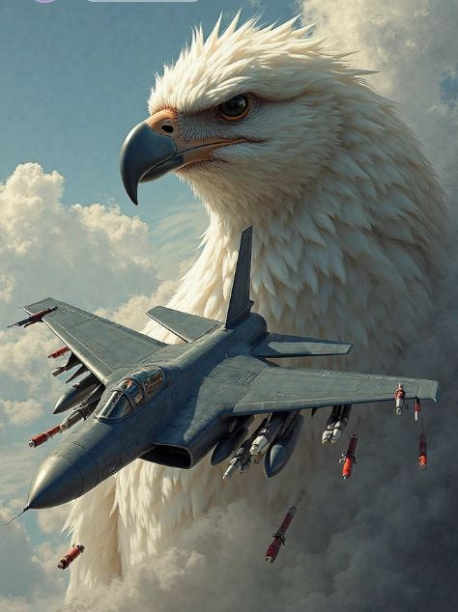
Communication & Training
Flights where pilots were warned in advance of bird activity experienced less severe outcomes, including fewer engine shutdowns and emergency procedures.
In contrast, unanticipated bird strikes led to more disruptions and safety risks.
Pilot warning mechanisms appear underutilized or inconsistent across airports

Slide 11





Summary Insights
Safety
Strikes during approach/takeoff most common
Cost
Over $20M in losses , can be reduced
Efficiency
Dusk/dawn flights = higher risk
Conservation
Focus on Small- Medium Species
Risk
Aircraft size , location, time all matter

Slide 12
Business Recommendation
Install avian radars in high-risk airports
Use falconry & habitat control to reduce bird presence
Schedule flights to avoid known strike windows
Standardize pilot alert systems across ATC
Build predictive alert tools using AI/ML models

Slide 13
THANK YOU
“
”
Saravanan S

